Slide 1
Advanced Computational Methods in Geotechnical Engineering
Lecture
May 21, 2009

Slide 2
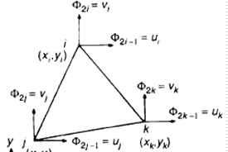
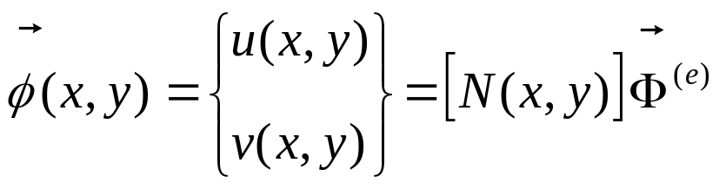
In our last class we have discussed:
Interpolation functions for vector quantities.
Linear Interpolation Polynomials in terms of Local (Natural) Coordinates .
Higher order Interpolation functions.

Slide 3











5.3.5 Higher Order Elements in terms of Natural Coordinates
1D Quadratic Elements
The natural coordinates L₁ and L₂ for 1D linear elements are as shown below (previous lecture Slide 13).
Node 1
Node 2

Slide 4
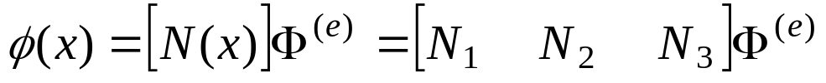
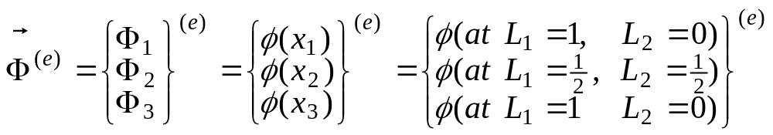




For a 1D quadratic model the interpolation function can be expressed as:
-Where:
Node 1
Node 2
Node 3

Slide 5
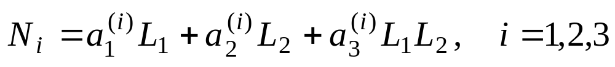


And the quadratic nodal interpolation (shape) function can be expressed in a general form (text book pp. 116, Eqn. 4.14):
***
For N₁ the following requirements are imposed :
1 at node 1 (L₁ =1, L₂=0)
0 at node 2 (L₁ = , L₂= )
0 at node 3 (L₁ =0, L₂=1)

Slide 6
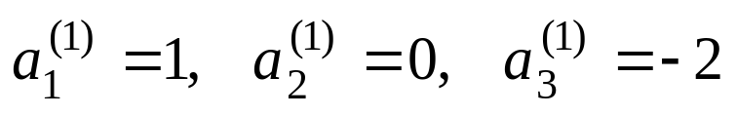

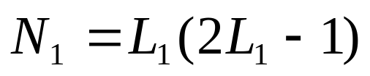


and find the values of the constants:
Therefore eqn. *** becomes:
- By using the condition L₁+L₂ = 1
Similarly the other nodal interpolation functions can be derived as:

Slide 7
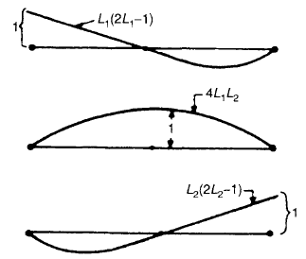



Nodal interpolation or shape functions for a line element with quadratic model

Slide 8
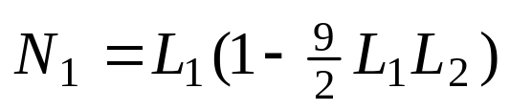
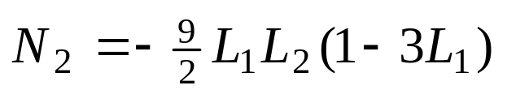
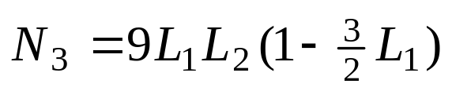
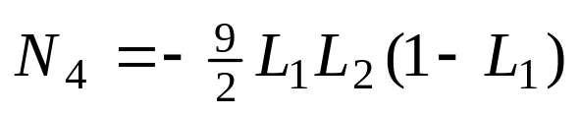
1D Cubic Elements
For a cubic model the interpolation function can be expressed as:
Following similar procedures used in the quadratic element case (as shown in text book pp. 116 to 117), we have:

Slide 9
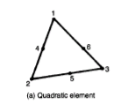
2D Triangular Elements (quadratic)
The natural coordinates L₁, L₂ & L₃ for a triangular coordinate system are as explained in previous lecture (s16).
The interpolation function for a quadratic model can be expressed as:
And derivation of N_{i} are as shown in text book (pp. 117 to 118):

Slide 10
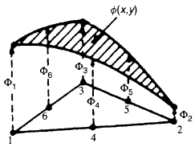
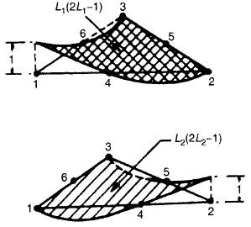
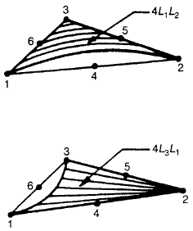




Nodal interpolation or shape functions for a triangular element of quadratic model (text book pp. 119)
2D Triangular Elements (cubic)
- Refer text book pp. 118 to 120

Slide 11
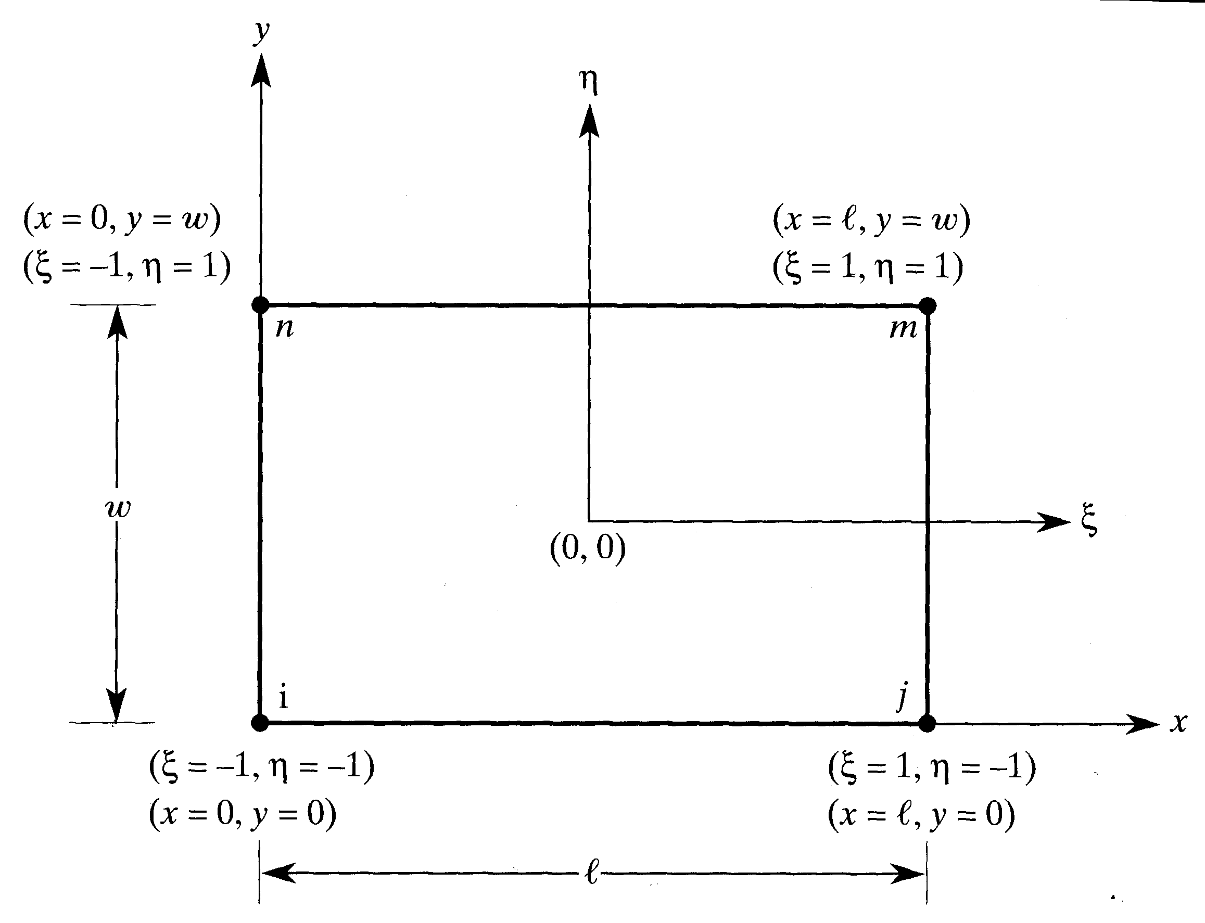
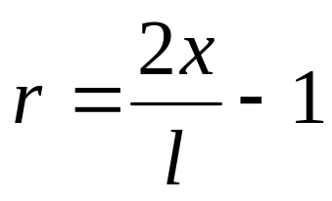
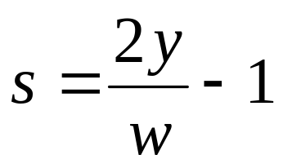


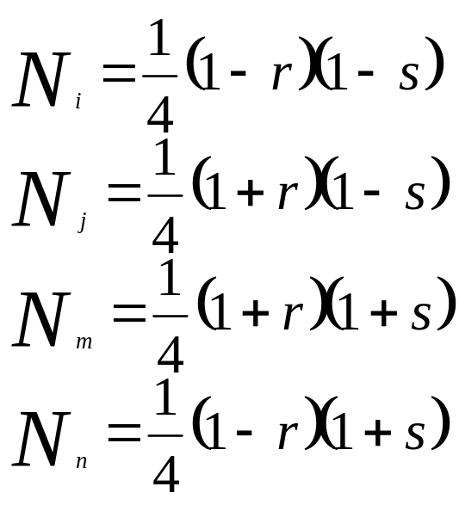


2D Quadrilateral Element
s
r
Example: SIGMA/W (pdf_pp 399)

Slide 12
6 Formulation of FE Equations
6.1 Derivation of Element Response Matrices
Element Matrices:
Direct Approach
Variational Approach
- Rayleigh-Ritz Method
Weighted Residual Approach
- Galerkin Method

Slide 13








Direct Approach (Elasticity Problem)
Uses direct physical reasoning.
Limited only to simple types of elements.
Example Derivation in Text book (S. S. Rao pp. 163)
Consider a stepped bar:
a) Physical System

Slide 14





node 1
node 2
node 3
node 4
b) FE discretization
node 1
node 2
c) One element of the system
force=k₁₁
force=k₂₁=-k₁₁
c) Finding k₁₁, k₂₁

Slide 15
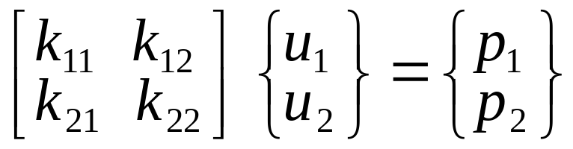
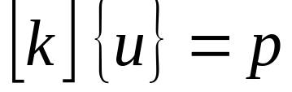



Required element equation: Force-displacement equation.
[k] : stiffness matrix
: vector of nodal displacements
: vector of nodal forces
Stiffness Matrix: can be derived from the basic definition of stiffness influence coefficient in structural mechanics.
- = force needed at node i to produce a unit displacement at node j (u_{j}=1) while all other nodes are restrained.

Slide 16



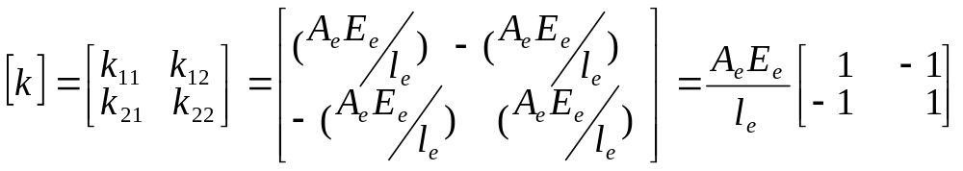
- Example (Figure d)
Force at node 1 =
Reaction at node 2 =
Similarly:
- Thus the stiffness matrix of the element is given by:

Slide 17

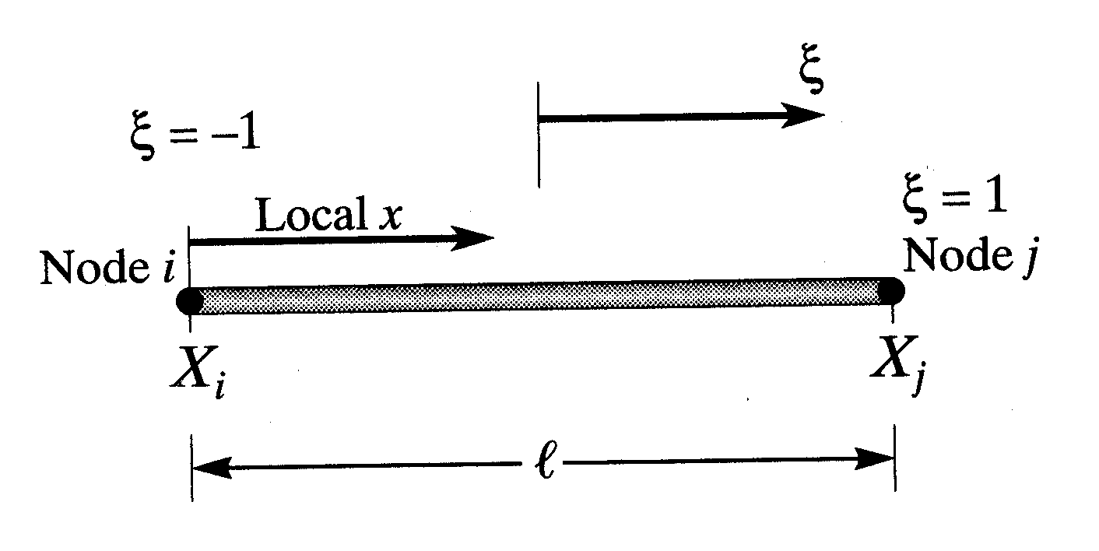
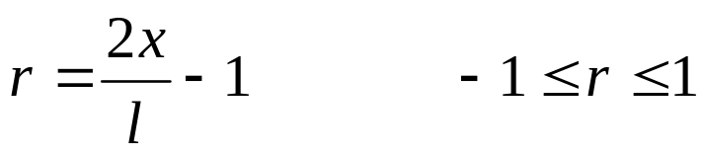
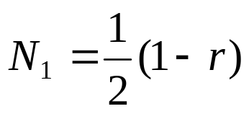
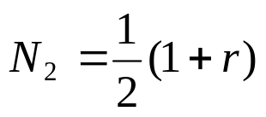
Another way of derivation (Beer & Watson, 1994)
Other natural coordinates
r
r
r
r

Slide 18









Consider a bar fixed at one end and subjected to a force on the other end.
The first step is the description of element geometry. The coordinate x of a point in terms of the natural coordinate is given by:
(A)
The actual displacement in the bar is expressed by:
Where u_{x1} and u_{x2} are nodal displacements.

Slide 19
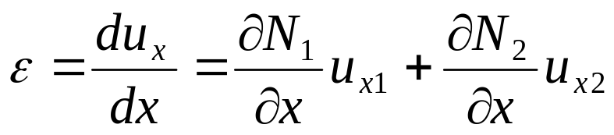

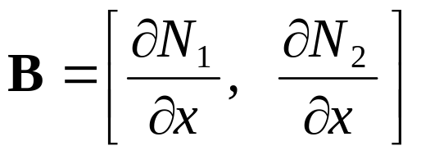
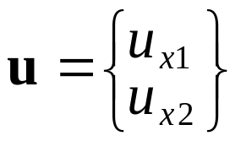
The strain in the bar is given by:
Or in matrix form:
Where the element strain-displacement matrix is given by:
And the nodal displacement vector is given by:

Slide 20
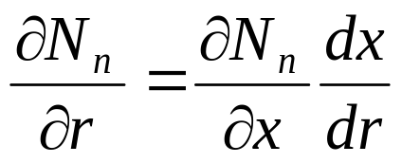
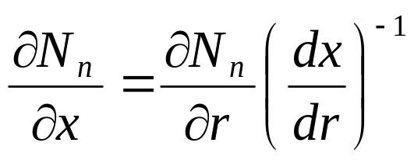
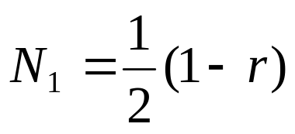
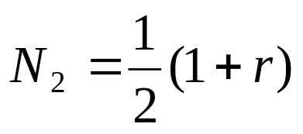
Since the shape functions are expressed in terms of the natural coordinate, we have by the chain rule:
or:
For a linear element the shape functions are:

Slide 21
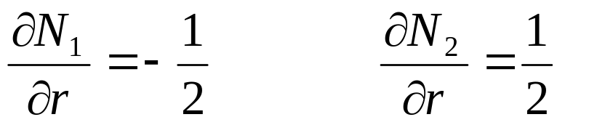
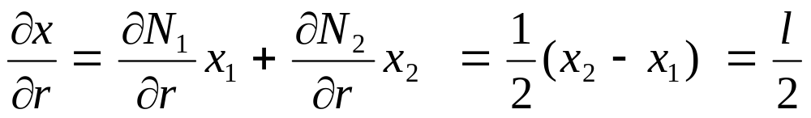
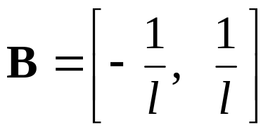
And hence:
And from eqn.(A) we have:
The B matrix is therefore given by:

Slide 22



For an elastic material we have:
Where E is the Young’s Modulus.
Assume that the forces at the ends of the bar are F₁ and F₂ then for equilibrium we must have:

Slide 23
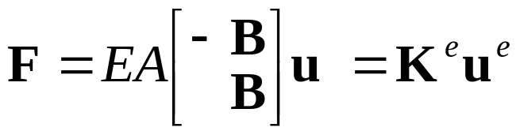
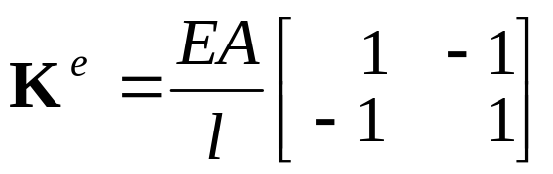
Where A is the cross sectional area. Written in matrix form this becomes:
Where the element stiffness matrix is given by:
Same as in slide 16

Slide 24
Variational Approach … Next Class

